Slide 1
Restful web Services
Restful Web Services is a lightweight, maintainable, and scalable service that is built on the REST architecture. Restful Web Service, expose API from your application in a secure, uniform, stateless manner to the calling client. The calling client can perform predefined operations using the Restful service. The underlying protocol for REST is HTTP. REST stands for Representational State Transfer.
REST is a way to access resources which lie in a particular environment. For example, you could have a server that could be hosting important documents or pictures or videos. All of these are an example of resources. If a client, say a web browser needs any of these resources, it has to send a request to the server to access these resources. Now REST services defines a way on how these resources can be accessed.

Slide 2
Restful Methods
1.POST- This would be used to create new record using RESTful web service
2. GET-Used to get a list of record using RESTful web service
3. PUT- Used to update all employee using RESTful web service
4.DELETE- Used to delete all employee using RESTful services.
GET:-
http://ncit.edu.np/student/1

Slide 3
Web Architecture Style
Service Orinted Architecture (SOA)
Object Oriented Architecture (OOA)
Resource Oriented Architecture(ROA)

Slide 4
SOA (Service Oriented Architecture)
-SOA is architecture oriented at service
Service:-
Software or piece of code that perform specific task or response to particular event as per request and produce specific output
It is logical representation of repeatable business activities that have specified output.
Ex:- Weather Predictor, accessing stock price
- SOA is a web architectural style of web service, but it is not any programming language or technology
It defines best approach to design and develop a web service
It is a set of principles, procedures and methodologies
System is made up of service and those services performs some operations and they can communicate with each other

Slide 5
Service Oriented Architecture(SOA)
-Internally , service can consist of many parts
Ex: Getting data from database, Calling external system, Applying some algorithms
Black Box, Consumer of SOA doesn’t know internally how it produces output.
Stateless, Server doesn’t store any information related to client state, and client is responsible to pass information necessary for communication. - Highly Scalable
Interface Description:- Additionally each service in SOA have interface description such as WSDL file, which defines the message and payload formats.
Ex:- SOAP over HTTP , SOAP Over JMS

Slide 6
Object Oriented Architecture (OOA)
-OOA is architecture oriented at object
Communication with an object instance and mainly it is for managing lifecycle of object.
Ex:- Create and Remove methods
Stateful, Server stores all information about state, and communication with previously created object instance.
Object Access, requires close call or round trip for communication at server, means multiple network calls.
Design patterns offer solution for that with retrieving bulk data to reduce network calls.

Slide 7
Resource Oriented Architecture (ROA)
- A foundation of the semantic web or web 3.0
ROA is an architecture oriented to resource
Resource
Resource is anything that can be stored in computer, any document or data.
A record in database, file or document or result of algorithm as a resource
Ex:- Retriving HTML page with GET request or database Table
- The idea of ROA is to use web technologies(HTTP,URI and XML/JSON) with the core design principles and providing guidelines to support and implement interaction or resources

Slide 8
Concept and Properties of ROA
Resource Provider:
Server that provides resource is resource providers
Ex:- AWS (Amazon web services) and Microsoft Azure
Resource:-
Ex:- Servers , devices , web pages JavaScript document , data
Resources will have name and unique address or path to it.
Resource representational:-
It is the useful information about the current state of a resource , specified with a specific format in a specific language
Ex:- Transcript of some speech in multiple language
Resource link and connectedness:-
Resource link means another resource or the resource itself. Connectedness is al about how reliable and relevant the resource inks are.
Ex:- One resource connected with other resource of same kind (watching videos on youtube)

Slide 9
Concept and properties of ROA
Statelessness:-
Server won’t store any client state related information , every request should be self-contained.
The uniform interface:-
Uniform interface means all services should happened same way.
Ex:- POST, GET,PUT,DELETE

Slide 10
Benefits of ROA
Scalability and Performance:
Because of Statelessness and no session stickness-it is possible to achieve good performance and scalability.
Explicit State:-
Client and server will have explicit state
Every request will be independent
No Contract
ROA follows HTTP Protocols
No need to establish any new contract and connections between client and server
SOA can use SOAP a simple Object Access Protocol or REST and ROA uses REST

Slide 11
Build a Spring Boot REST API with Java – Easy Steps
An Application Programming Interface (API) establishes a connection between computers or between computer programs (applications) by providing readily available codes and information pipelines. It is a type of software interface that acts as a mediator among other pieces of software to streamline the interaction with one other. Owing to diverse applications architectures, different types of APIs (such as Program, Local, Web, or REST API) assist developers in building robust digital solutions.
Representational State Transfer, also known as REST, is basically a standardized Software Architecture Style, or in simple words, a specific type of API used by the industry to establish a connection between Client and Server. REST API is built to guide the development and design of the World Wide Web’s architecture.
REST APIs provide a flexible, lightweight way of integrating computer applications. REST APIs are a simple and standardized approach to communication, which means you don’t have to worry about how to format your data, it’s all standardized and industry use. REST APIs are scalable as well, which means as your service scales, you don’t have to worry about the growing complexity. You can easily make modifications to your data and keep track of that across Clients and Servers. They support caching which ensures high performance in large part.

Slide 12
What is JAVA Spring Boot?
Spring Boot is a Java-based framework used to create stand-alone, production-grade Spring based Applications with ease. There are two words here, Spring and Boot. Spring is a huge framework that lets you write enterprise JAVA applications, and Boot is a bootstrap that lets you bootstrap a Spring application from scratch. This is how it gets its name, Spring Boot.
Key Features of Spring Boot
Ability to create stand-alone Spring Applications and Microservices with minimal configuration and setup.
Can automatically configure Spring Libraries and third-party libraries as well.
Access to powerful features such as Key Metrics, Health Checks, and Externalized Configuration.
Simplifies your build configuration by providing opinionated ‘starter’ dependencies.
Requires no code generation and XML configuration.

Slide 13
Prerequisites
To build a Spring Boot REST API with Java, you’re required to have:
an IDE or a text editor
JDK 1.8+
Maven 3+
Building a Spring Boot REST API in Java
Follow the below-mentioned steps to build a Spring Boot REST API using Java.
Step 1: Initializing a Spring Boot Project
Step 2: Connecting Spring Boot to the Database
Step 3: Creating a User Model
Step 4: Creating Repository Classes
Step 5: Creating a Controller
Step 6: Compile, Build and Run
Step 7: Testing the APIs

Slide 14
Step 1: Initializing a Spring Boot Project
To start with Spring Boot REST API, you first need to initialize the Spring Boot Project. You can easily initialize a new Spring Boot Project with Spring Initializr.
From your Web Browser, go to start.spring.io. Choose Maven as your Build Tool and Language as Java. Select the specific version of Spring Boot you want to go ahead with.
ou can go ahead and add a few dependencies to be used in this project.
Spring Data JPA – Java Persistence API and Hibernate.
Spring Web – To include Spring MVC and embed Tomcat into your project.
Spring Boot DevTools – Development Tools.
MySQL Driver – JDBC Driver (any DB you want to use).
Once you’re done with the configuration, click on “Generate”. A ZIP file will then be downloaded. Once the download is finished, you can now import your project files as a Maven Project into your IDE (such as Eclipse) or a text editor of choice.

Slide 15
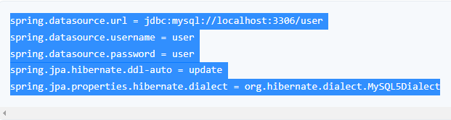
Step 2: Connecting Spring Boot to the Database
Next, you need to set up the Database, and you can do it easily with Spring Data JPA.
Add some elementary information in your application.properties file to set up the connection to your preferred Database. Add your JDBC connection URL, provide username and password for authentication, and set the ddl-auto property to update. Hibernate has different dialects for different Databases. Hibernate automatically sets the dialect for different Databases, but it’s a good practice to specify it explicitly.

Slide 16
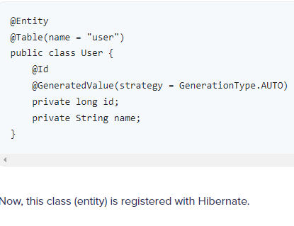
Step 3: Creating a User Model
The next step is to create a Domain Model. They are also called Entities and are annotated by @Entity.
Create a simple User entity by annotating the class with @Entity. Use @Table annotation to specify the name for your Table. @Id annotation is used to annotate a field as the id of an entity. Further, set it as a @GeneratedValue and set the GenerationType to AUTO

Slide 17
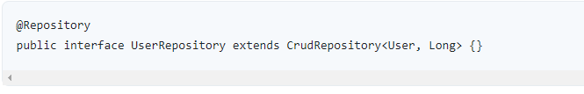
Step 4: Creating Repository Classes
To perform CRUD (Create, Read, Update, and Delete) operations on the User entities, you’ll need to have a UserRepository. To do this, you’ll have to use the CrudRepository extension and annotate the interface with @Repository.

Slide 18
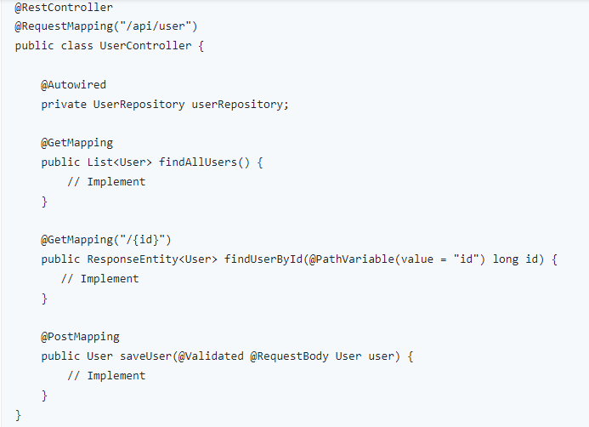
Step 5: Creating a Controller
You’ve now reached the Business Layer, where you can implement the actual business logic of processing information.
@RestController is a combination of @Controller and @ResponseBody.Create a UserController as shown below.

Slide 19
You’ve to @Autowired your UserRepository for dependency injection. To specify the type of HTTP requests accepted, use the @GetMapping and @PostMapping annotations.
Let’s implement the findAll() endpoint. It calls the userRepository to findAll() users and returns the desired response.
@GetMapping
Public List<User> findAllUsers(){
Return userRepository.findAll();
}

Slide 20
To get each user by their id, lets implement another point
@GetMapping(“/{id}”)
Public ResponseEntity<User> findUserById@PathVariable(value=“id”) long id) {
Optional<User> user=userRepository.findById(id);
If(user.isPresent()){
Return ResponseEntity.ok().body(user.get());
}
else {
Return ResponseEntity.notFound().build();
}
}
Note:- If the user.isPresent(), a 200 OK HTTP response is returned, else, a ResponseEntity.notFound() is returned.

Slide 21
Now, let’s create an endpoint to save users. The save() method saves a new user if it isn’t already existing, else it throws an exception
@PostMapping
Public User saveUser(@Validated @RequestBody User user) {
Return userRepository.save(user);
}
Note:- The @Validated annotation is used to enforce basic validity for the data provided about the user. The @RequestBody annotation is used to map the body of the POST request sent to the endpoint to the User instance you’d like to save.
Conclusion:- API is a bigger umbrella, and REST API is a unique type of API prevalent among cloud applications. REST APIs are all about communication

Slide 22
References
https://stackabuse.com/creating-a-rest-api-in-python-with-django/
https://www.guru99.com/restful-web-services.html
https://hevodata.com/learn/spring-boot-rest-api/
https://spring.io/guides/tutorials/rest/
https://www.youtube.com/watch?v=nN2Vp15AW5w
https://rapidapi.com/blog/how-to-build-an-api-in-python/
https://rapidapi.com/blog/python-django-rest-api-tutorial/

